Slide 1
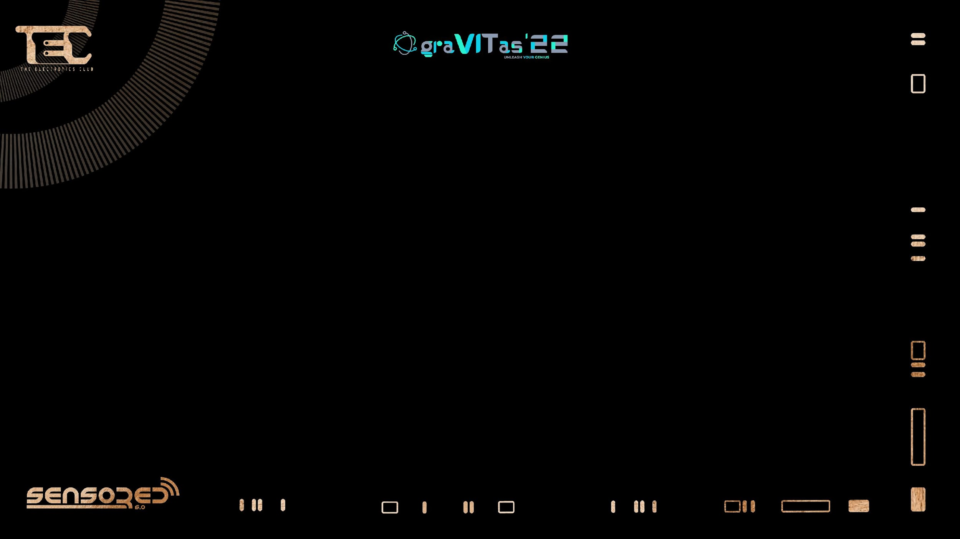


Slide 2

High Level vs Low Level Programming Languages.

Slide 3

…Programming Language?

Slide 4
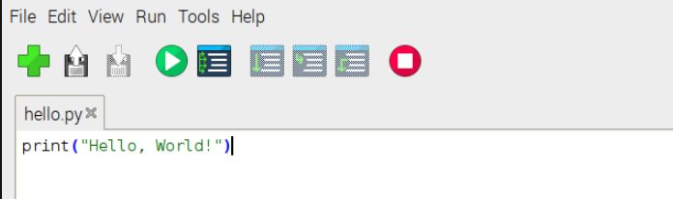
High Level Language:
User friendly and easy to understand/debug
Relatively simple syntax
easy to port to other platforms.
Disadvantage: machine takes time to process it before it reaches the hardware.
Examples of HL languages: Java, C++, and Python.

Slide 5
Now that we know what a HIGH level programming language is….

Slide 6
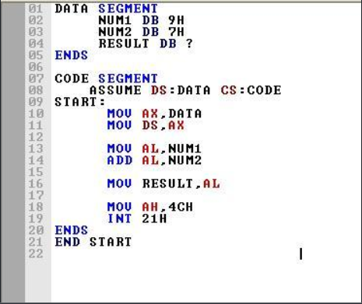
What are Low Level Languages?
not very user friendly.

Slide 7
Cannot be easily ported to other platforms.
Advantage: really fast to process and obtain the output.
Examples: Assembly and Machine Language

Slide 8
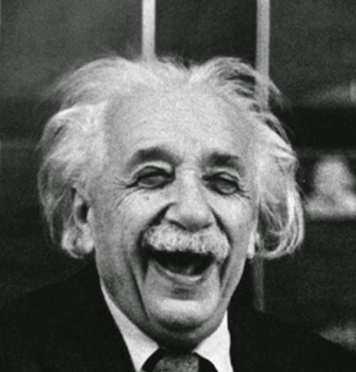
Q: Is C a high or a low level language?
High Level.

Slide 9



Slide 10
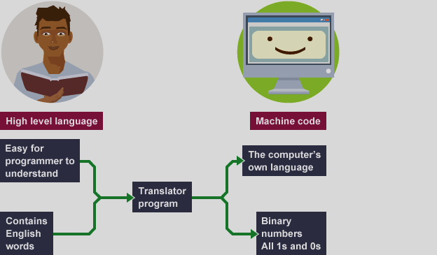
Why do they both exist?

Slide 11
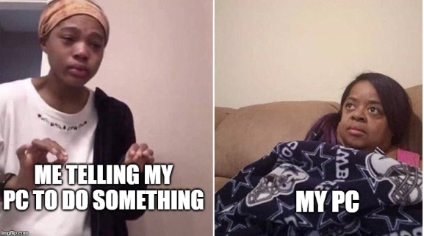

Slide 12
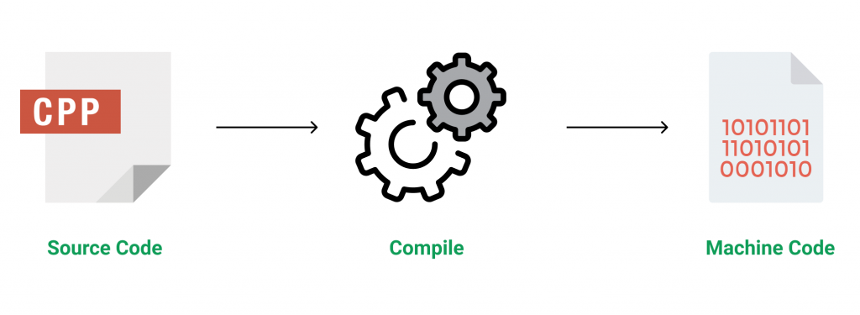

Slide 13
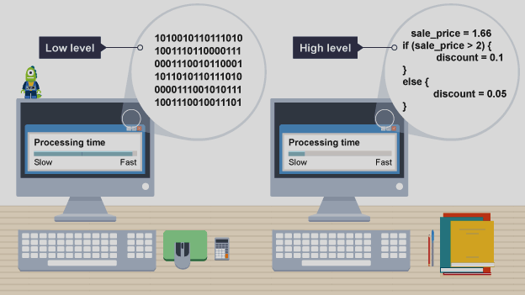

Slide 14
So what should I use?
In most cases, only a high level programming language is required
Low level is used for coding programs closely linked to hardware.

Slide 15
C++ : A High Level Programming Language.
WORA- Write Once Run Anywhere
Easy to understand
Object Oriented Programming Language
Robust and easily portable

Slide 16



Applications of C++
Google chrome
YouTube
Amazon

Slide 17

What’s the difference between C++ and Python?

Slide 18
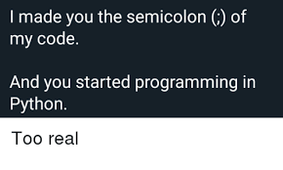
Difference 1: Syntax
C++will throw an error if you miss a semicolon at the end of the line.
E.g. cout(“Hi”) will throw an error.
Python will still work even if you do not put a semicolon.
E.g. print(“Hi”) still works.

Slide 19

Difference 2: Speed
C++ is much faster.
Python is slower.

Slide 20
Difference 3: User Friendliness
C++ is much harder to learn.
Python is easier to learn and understand.

Slide 21
Speaker : Rijuta Saraswat

Slide 22
Micro controllers
Micro processors

Slide 23
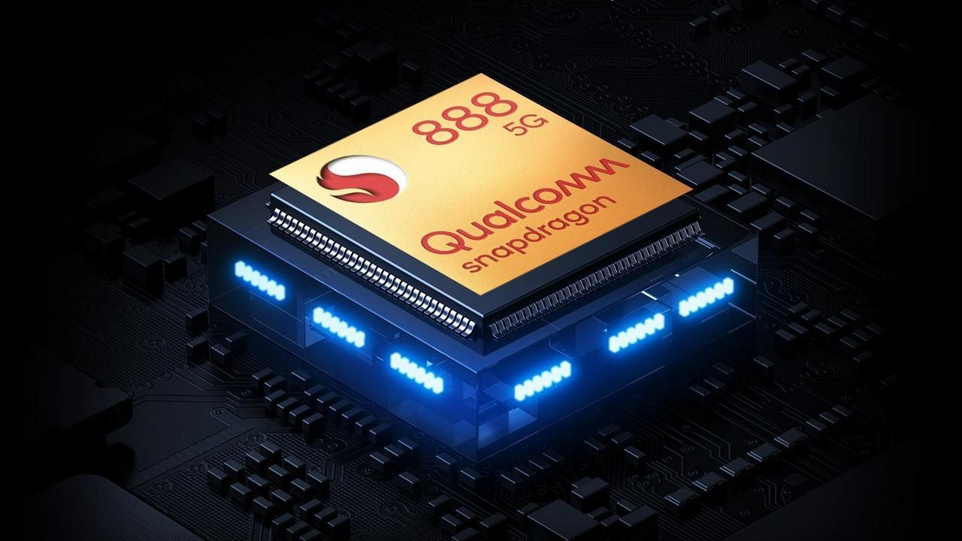
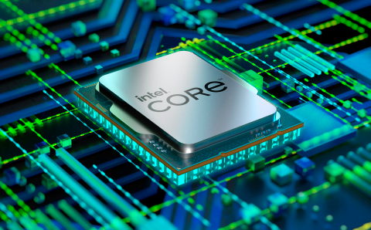
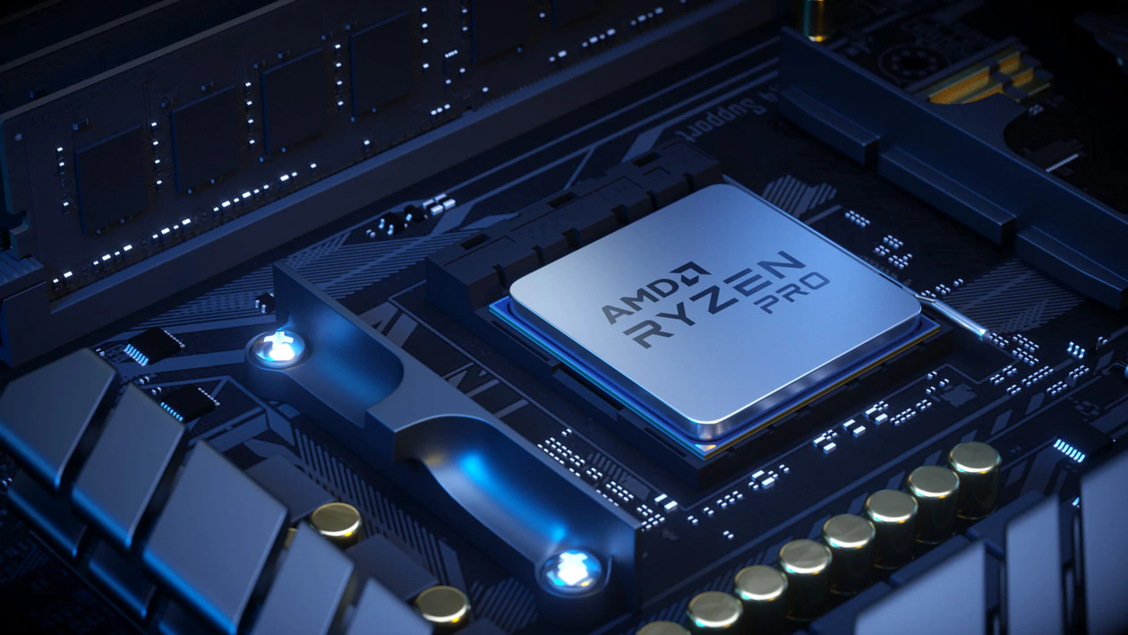
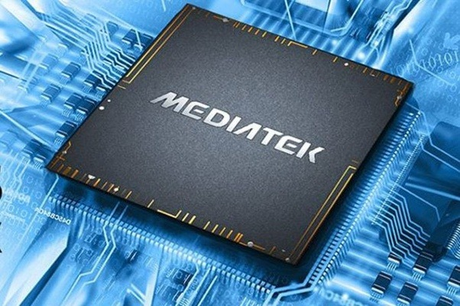
processors
MICROPROCESSORSOR

Slide 24
A microprocessor is a computer processor where the data
processing logic and control is included on a single
integrated circuit, or a small number of integrated circuitf integrated circuits.

Slide 25


Slide 26
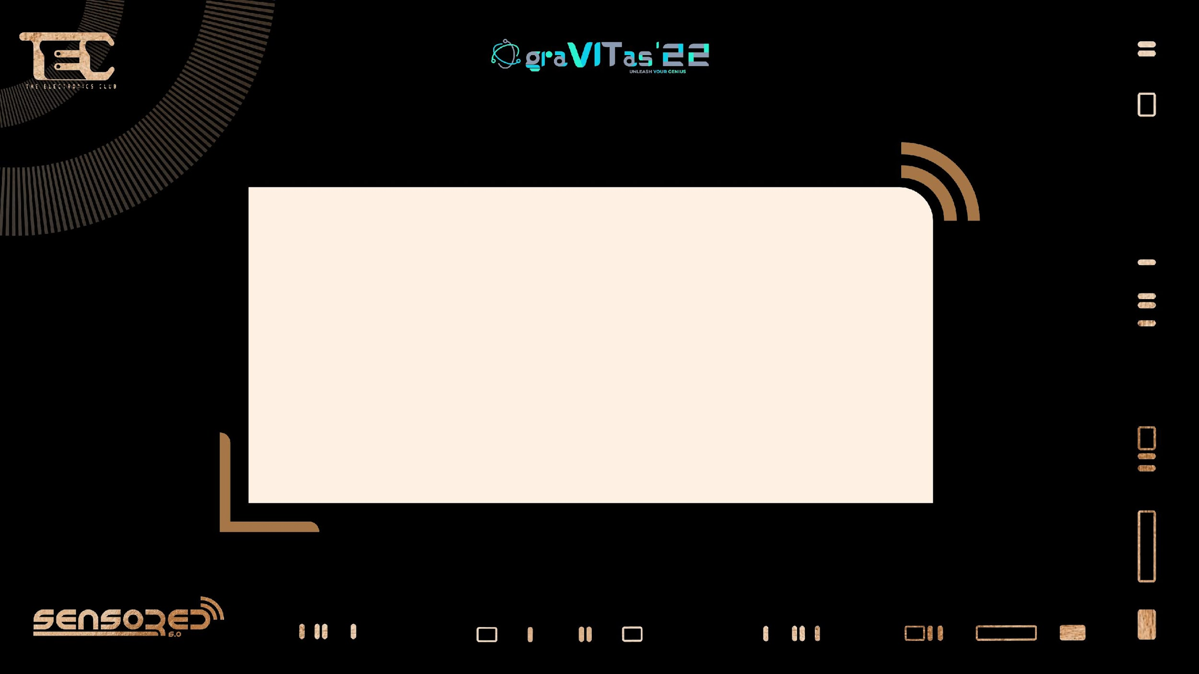
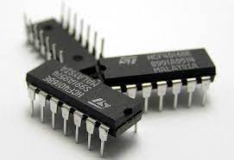
Notes:
Microprocessor is the part of computer which processes the input information and provide the desired output according to the given command

Slide 27
Parts of microprocessor
1.the input unit
2.the output unit
3.the arithmetic logic unit (ALU)
4.the control unit

Slide 28

INPUT UNIT
The input unit consists of all of the devices used to take information and
data that are external to the computer.
OUTPUT UNIT
The output unit consists of the devices used to transfer data and
information from the computer to the “outside world.”

Slide 29

ARITHMETIC LOGIC UNITUNIT (ALU)
The arithmetic and logic unit (ALU) is that part of the computer
that actually performs arithmetic and logical operations on data.
All other elements of the computer system - control unit , memory,
I/O are there mainly to bring data into the ALU to process and
then to take the results back out.
.
Notes:
All the logic operations takes place from basic adding two numbers to complex equations

Slide 30
CONTROL UNIT
Control unit is like the conductor of an orchestra, who is responsible for
keeping each of the orchestra members in proper synchronization. This
unit contains logic and timing circuits that generate the proper signals
necessary to execute each instruction in a program
Notes:
IT’s like the manager of microprocessor , its job is to manage or you can say to input signal for proper and synchronized executoperations in proper order

Slide 31


Slide 32
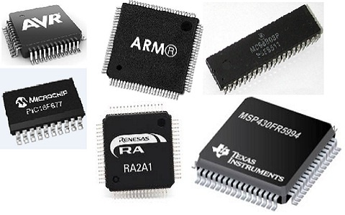
Microcontrollers

Slide 33
A microcontroller is a compact integrated circuit designed to
govern a specific operation in an embedded system.
A typical microcontroller includes a processor, memory and
input/output (I/O) ports on a single chip.

Slide 34

Now What The Hell Is
EMBBEDED SYSTEM
Notes:
microcontroller or microprocessor based system which is designed to perform a specific task. So in the embedded system microcontroller acts as an governing body

Slide 35
PARTS OF MICROCONTROLERS
ADC
CPU
MEMORY
I/O PORTS
TIMERS/COUNTERS
INTERRUTPS

Slide 36
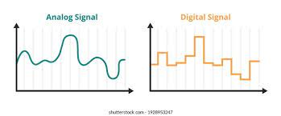

ANALOG DIGITAL CONVERTER
Analog digital converter is the device that converts analog signal to digital signal which is important for working of microcontroller

Slide 37

THE PROCESSOR (CPU) -
The processor (CPU) -- A processor can be thought of as the brain of the device.
It processes and responds to various instructions that
direct the microcontroller's function.

Slide 38

MEMORY
A microcontroller's memory is used to store the data that the processor receives and uses to respond or execute functions or instructions that it's been programmed to carry out.
Notes:
Storage unit

Slide 39
TIMERS
A timer is a specialized type of clock which is used to measure time intervals. A timer that counts from zero upwards for measuring time elapsed is often called a
stopwatch.

Slide 40
COUNTERS
A counter is a device that stores (and sometimes displays) the number of times a particular event or process occurred, with respect to a clock signal. It is used to count the events happening outside the microcontroller

Slide 41

INTERRUPTS
It is a method of creating a temporary halt
during a program execution and allow input
output devices to access the microprocessor

Slide 42
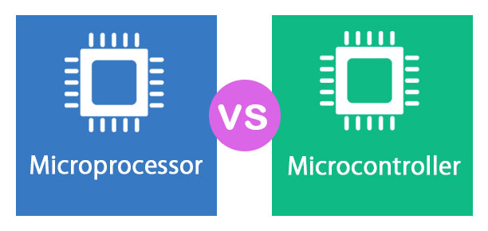

Slide 43
MICROPROCESSOR | MICROCONTROLLER
Microprocessors have externally attached input and output ports | Microcontrollers have inbuilt input output ports
They do not have there own memory | They have there own memeory
Microprocessors are usually general purpose device | Microcontroller are designed to carry out very specific operation
It is mainly used in personal computers Mobile phones etc. | It is mainly used in washing machines, air conditioners etc.

Slide 44

Thank you
SPEAKER-
VAIBHAV KAPOOR

